Slide 1
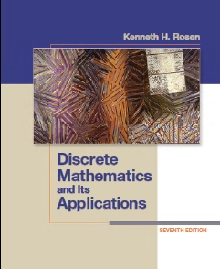
CSE 101: Discrete Mathematics
Slide 08 Counting
Department of Computer Science and Engineering(CSE)
Green University of Bangladesh(GUB)
Notes:
‹#›

Slide 2
Counting
Assume we have a set of objects with certain properties.
Counting is used to determine the number of these objects.
Examples:
Number of available phone numbers with 11 digits in the local calling area.
Number of possible matches (football, cricket) given the number of team members.
Notes:
‹#›

Slide 3
Basic Counting Rules
Counting problems may be very hard, not obvious
Solution:simplify the solution by decomposing the problem
Two basic decomposition rules:
Product rule: A count decomposes into a sequence of dependent counts
(“each element in the first count is associated with all elements of the second count”)
Sum rule: A count decomposes into a set of independent counts
(“elements of counts are alternatives”)
Notes:
‹#›

Slide 4
Product Rule
A count can be broken down into a sequence of dependent counts “each element in the first count is associated with all elements of the second count”
Example:
Assume an auditorium with a seat labeled by a letter and numbers in between 1 to 50 (e.g. A23). We want the total number of seats in the auditorium.
26 letters and 50 numbers. How to count?
One solution: write down all seats (objects) and count them
A-1 A-2 A-3 …A-50 B-1… Z-49 Z-50
1 2 3 50 51 … (n-1) n ← eventually we get it
Notes:
‹#›

Slide 5
Product Rule
26 letters and 50 numbers. How to count?
One solution: write down all seats (objects) and count them
A-1 A-2 A-3 …A-50 B-1… Z-49 Z-50
1 2 3 50 51 … (n-1) n ← eventually we get it
A better solution?
For each letter there are 50 numbers
So the number of seats is 26*50 = 1300
Product rule: number of letters * number of integers in [1,50]
Notes:
‹#›

Slide 6
Product Rule
A count can be broken down into a sequence of dependent counts “each element in the first count is associated with all
elements of the second count”
Product rule: If a count of elements can be broken down into a sequence of dependent counts where the first count yields n1 elements, the second n2 elements, and kth count nk elements, by the product rule the total number of elements is:
n = n1*n2* …* nk
Notes:
‹#›

Slide 7
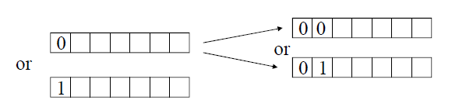
Product Rule
Example:
How many different bit strings of length 7 are there? E.g. 1011010
Is it possible to decompose the count problem and if yes how?
Yes.
Count the number of possible assignments to bit 1
For the specific first bit count possible assignments to bit 2
For the specific first two bits count assignments to bit 3
Number of assignments to the first 3 bits: 2*2*2=8
Gives a sequence of n dependent counts and by the product rule we have: n = 2* 2 * 2 * 2 * 2 * 2 *2 = 2⁷
Notes:
‹#›

Slide 8
Sum Rule
A count decomposes into a set of independent counts “elements of counts are alternatives”, they do not depend on each other.
Example:
You need to travel in between city A and B. You can either fly, take a train, or a bus. There are 3 different flights in between A and B, 2 different trains and 10 buses. How many options do you have to get from A to B?
We can take only one type of transportation and for each only one option. The number of options: n = 3+2+10
Sum rule:
n = number of flights + number of trains + number of buses
Notes:
‹#›

Slide 9
Sum Rule
A count decomposes into a set of independent counts “elements of counts are alternatives”
Sum rule: If a count of elements can be broken down into a set of independent counts where the first count yields n1 elements, the second n2 elements, and kth count nk elements, by the sum rule the total number of elements is:
n = n1+n2+ …+ nk
Notes:
‹#›

Slide 10
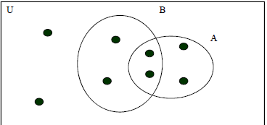
Inclusion Exclusion Principle
Used in counts where the decomposition yields two dependent count tasks with overlapping elements
If we used the sum rule some elements would be counted twice Inclusion exclusion principle: uses a sum rule and then corrects for the overlapping elements.
We used the principle for the cardinality of the set union.
|A U B| = |A| + |B| - |A ∩ B|
Notes:
‹#›

Slide 11
Inclusion Exclusion Principle
Example: How many bit strings of length 8 start with a bit 1 or end with 00?
It is easy to count strings that start with 1. How many are there? 2⁷
It is easy to count the strings that end with 00. How many are there? 2⁶
Is it OK to add the two numbers to get the answer? 2⁷ + 2⁶
No. Overcount. There are some strings that can both start with 1 and end with 00. These strings are counted in twice.
How to deal with it? How to correct for overlap?
How many of strings were counted twice? 2⁵ (1 xxxxx 00)
Thus we can correct for the overlap simply by using:
2⁷ + 2⁶ – 2⁵ = 128+ 64-32 = 160
Notes:
‹#›

Slide 12
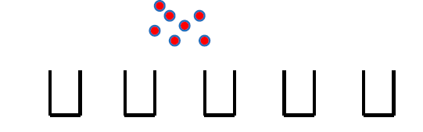

Pigeonhole principle
Assume you have a set of objects and a set of bins used to store objects.
The pigeonhole principle states that if there are more objects than bins then there is at least one bin with more than one object.
Example: 7 balls and 5 bins to store them
At least one bin with more than 1 ball exists.
Notes:
‹#›

Slide 13

Pigeonhole principle
Theorem. If there are k+1 objects and k bins. Then there is at least one bin with two or more objects.
Proof. (by contradiction)
Assume that we have k + 1 objects and every bin has at most one element. Then the total number of elements is k which is a contradiction.
End of proof
Notes:
‹#›

Slide 14
Pigeonhole principle
Example:
Assume 367 people. Are there any two people who has the same birthday?
How many days are in the year? 365.
Then there must be at least two people with the same birthday.
Notes:
‹#›

Slide 15
Generalized Pigeonhole principle
We can often say more about the number of objects.
Say we have 5 bins and 12 objects. What is it we can say about the bins and number of elements they hold?
There must be a bin with at least 3 elements. Why?
Assume there is no bin with more than 2 elements. Then the max number of elements we can have in 5 bins is 10. We need to place 12 so at least one bin should have at least 3 elements.
Notes:
‹#›

Slide 16
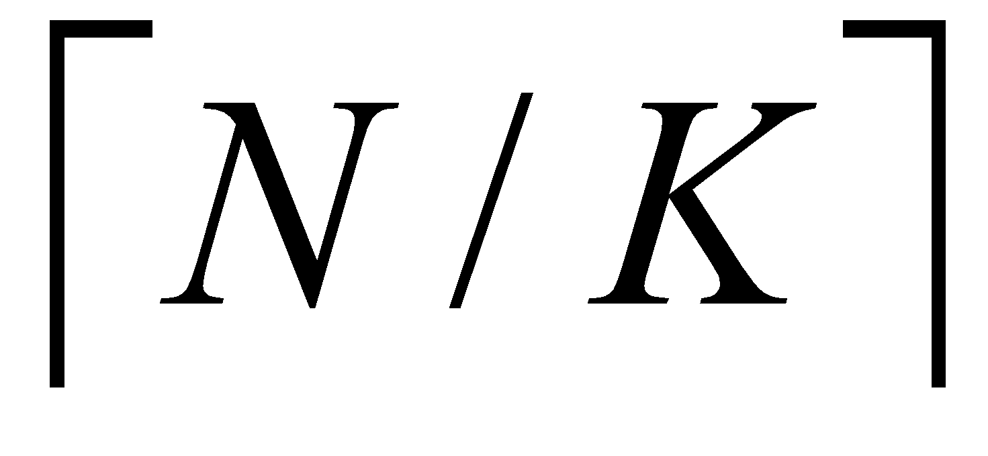
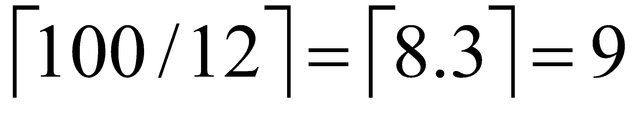
Generalized Pigeonhole principle
Theorem. If N objects are placed into k bins then there is at least one bin containing at least objects.
Example. Assume 100 people. Can you tell something about the number of people born in the same month.
• Yes. There exists a month in which at least
= people were born.
Notes:
‹#›

Slide 17
Generalized Pigeonhole principle
Theorem. If N objects are placed into k bins then there is at least one bin containing at least objects.
Example: What is the minimum number of students required in a discrete mathematics class to be sure that at least six will receive the same grades, (A,B,C,D and F)?
Solution: 6 = ceiling(N/5)
Formula: N = k ( r - 1 ) + 1
= 5 ( 6 - 1 ) + 1
= 26
N = total number of objects.
k = number of bins.
r = number of at least objects.
Notes:
‹#›

Slide 18
Permutations
A permutation of a set of distinct objects is an ordered arrangement of the objects.
Since the objects are distinct, they cannot be selected more than once. Furthermore, the order of the arrangement matters.
Example:
Assume we have a set S with n elements. S={a,b,c}.
Permutations of S:
a b c a c b b a c b c a c a b c b a
Notes:
‹#›

Slide 19
Number of Permutations
Assume we have a set S with n elements. S={a₁ a₂ … a_{n}}.
Question: How many different permutations are there?
In how many different ways we can choose the first element of the permutation? n (either a₁ or a₂ … or a_{n} )
Assume we picked a₂.
In how many different ways we can choose the remaining
elements? n-1 (either a₁ or a₃ … or a_{n} but not a₂)
Assume we picked a_{j}.
• In how many different ways we can choose the remaining
elements? n-2 (either a₁ or a₃ … or a_{n} but not a₂ and not a_{j})
P(n,n) = n.(n-1)(n-2)…1 = n!
Notes:
‹#›

Slide 20
Number of Permutations
Example 1.
How many permutations of letters {a,b,c} are there?
Number of permutations is:
P(n,n) =P(3,3) =3! = 6
Verify:
abc acb bac bca cab cba
Notes:
‹#›

Slide 21
Number of Permutations
Example 2
How many permutations of letters A B C D E F G H contain a substring ABC.
Idea: consider ABC as one element and D,E,F,G,H as other 5 elements for the total of 6 elements.
Then we need to count the number of permutation of these elements. 6! = 720
Notes:
‹#›

Slide 22
K-Permutations
k-permutation is an ordered arrangement of k elements of a set.
The number of k-permutations of a set with n distinct elements is:
P(n,k) = n(n-1)(n-2)…(n-k+1)= n!/(n-k)!
Explanation:
Assume we have a set S with n elements. S={a₁ a₂ … a_{n}}.
The 1st element of the k-permutation may be any of the n elements in the set.
The 2nd element of the k-permutation may be any of the n-1 remaining elements of the set.
And so on. For last element of the k-permutation, there are n-k+1 elements remaining to choose from
Notes:
‹#›

Slide 23
K-Permutations
Example:
The 2-permutations of set {a,b,c} are:
ab, ac, ba, bc, ca, cb.
The number of 2-permutations of this 3-element set is
P(n,k) = P(3,2) = 6.
Notes:
‹#›

Slide 24
Combination
A k-combination of elements of a set is an unordered selection of k elements from the set.
Thus, a k-combination is simply a subset of the set with k elements.
Example: 2-combinations of the set {a,b,c}
a b a c b c
a b covers 2-permutations: a b and b a
Notes:
‹#›

Slide 25
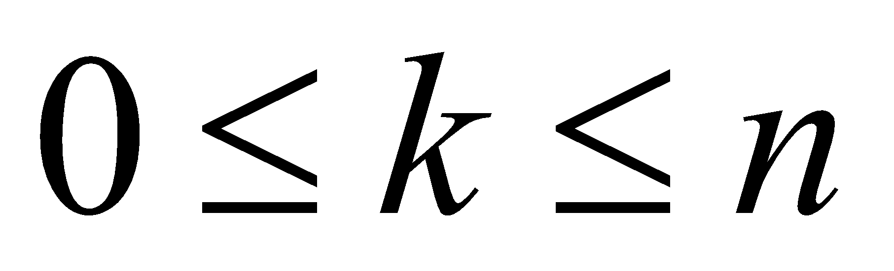
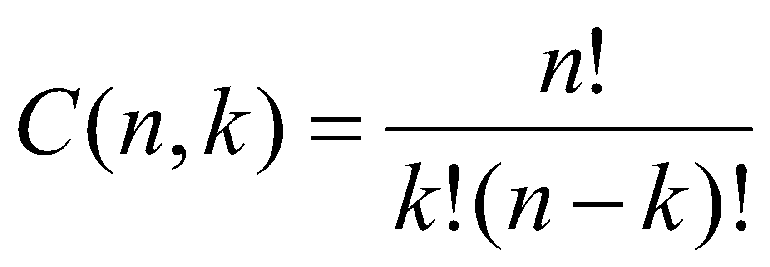
Combination
Theorem: The number of k-combinations of a set with n distinct elements, where n is a positive integer and k is an integer with
Proof: The k-permutations of the set can be obtained by first forming the C(n,k) k-combinations of the set, and then ordering the elements in each k-combination, which can be done in P(k,k) ways. Consequently,
P(n,k) = C(n,k) * P(k,k).
This implies that
C(n,k) = P(n,k) / P(k,k) = P(n,k) / k! = n! / (k! (n-k)!)
Notes:
‹#›

Slide 26
Combination
Intuition (example): Assume elements A1, A2, A3, A4 and A5 in
the set. All 3-combinations of elements are:
• A1 A2 A3
• A1 A2 A4
• A1 A2 A5
• A1 A3 A4
• A1 A3 A5
• A1 A4 A5
• A2 A3 A4
• A2 A3 A5
• A2 A4 A5
• A3 A4 A5
Total of 10.
Each combination cover many 3-permutations
A1 A2 A3
A1 A3 A2
A2 A1 A3
A2 A3 A1
A3 A1 A2
A3 A2 A1
So: P(5,3) = C(5,3) P(3,3)
and: C(5,3) = P(5,3)/P(3,3)
Notes:
‹#›

Slide 27
Combination
Example:
We need to create a team of 5 player for the competition out of 10 team members. How many different teams is it possible to create?
Answer:
When creating a team we do not care about the order in which players were picked. It is important that the player is in.
Because of that we need to consider unordered sets of combinations.
C(10,5) = 10!/(10-5)!5! = 252
Notes:
‹#›

Slide 28
Combination
Corollary: C(n,k) = C(n,n-k)
Example: C(5,2) = C(5,3)
Proof.
C(n,k) = n! / (n-k)! k!
= n!/ (n-k)! (n – (n-k))!
= C(n,n-k)
Notes:
‹#›

Slide 29
Caesar Cipher
Earliest known substitution cipher
By Julius Caesar
First attested use in military affairs
Example: replace each letter by 3rd letter on
f (a) = (a+3) mod 26
ENCRYPTION DECRYPTION
P | m | e | e | t |  | m | e |  | a | f | t | e | r |  | t | h | e |  | p | a | r | t | y
C | P | H | H | W |  | P | H |  | D | I | W | H | U |  | W | K | H |  | S | D | U | W | B

Slide 30
Caesar Cipher
can define transformation as:
a b c d e f g h i j k l m n o p q r s t u v w x y z
D E F G H I J K L M N O P Q R S T U V W X Y Z A B C
mathematically give each letter a number
a b c d e f g h i j k l m n o p q r s t u v w x y z
0 1 2 3 4 5 6 7 8 9 10 11 12 13 14 15 16 17 18 19 20 21 22 23 24 25
then have Caesar cipher as:
cipher text, c = Encryption(p) = (p + k) mod (26)
plain text, p = Decryption(c) = (c – k) mod (26)
Example: Apply caesar cipher with k = 2 in the plain text “HELLO”

Slide 31
Book References
Chapter 6.1(Page 385)
Chapter 6.2(Page 399)
Chapter 6.3(Page 407)
Problem (Problem 01 - 38) (Page 413)
Notes:
‹#›

Slide 32
Beyond basic counting rules
Extra Topic for Students’ reading
More complex counting problems typically require a
combination of the sum and product rules.
Example: A login password:
The minimum password length is 6 and the maximum is 8. The password can consist of either an uppercase letter or a digit. There must be at least one digit in the password.
How many different passwords are there?
Notes:
‹#›

Slide 33
Beyond basic counting rules
Step 1:
The password we select has either 6,7 or 8 characters. So the total number of valid passwords is by the sum rule: P = P6+P7+P8
The number of passwords of length 6,7 and 8 respectively
Step 2: Assume passwords with 6 characters
(either digits + upper case letters):
How many are there?
If we let each character to be at any position we have:
P6-all = (26+10)⁶=(36)⁶ different passwords of length 6
Notes:
‹#›

Slide 34
Beyond basic counting rules
Step 2 But we must have a password with at least one digit. How to
account for it?
A trick. Split the count of all passwords of length 6 into to two mutually exclusive groups: P6-all = P6-digits + P6-nodigits
1. P6-digits: count when the password has one or more digits
2. P6-nodigits: count when the password has no digits
We know how to easily compute P6-all and P6-nodigits
P6-all = 36⁶ and P6-nodigits = 26⁶
Then P6-digits = P6-all – P6-nodigits
Notes:
‹#›

Slide 35
Beyond basic counting rules
Step 1:
the total number of valid passwords is by the sum rule:
• P = P6+P7+P8
• The number of passwords of length 6,7 and 8 respectively
Step 2
The number of valid passwords of length 6:
P6= P6-digits = P6-all – P6-nodigits = 36⁶ –26⁶
Analogically:
P7= P7-digits = P7-all – P7-nodigits = 36⁷ –26⁷
P8= P8-digits = P8-all – P8-nodigits = 36⁸ –26⁸
Notes:
‹#›

Slide 36
Thank You

